Slide 1
HDLC and PPP

Slide 2
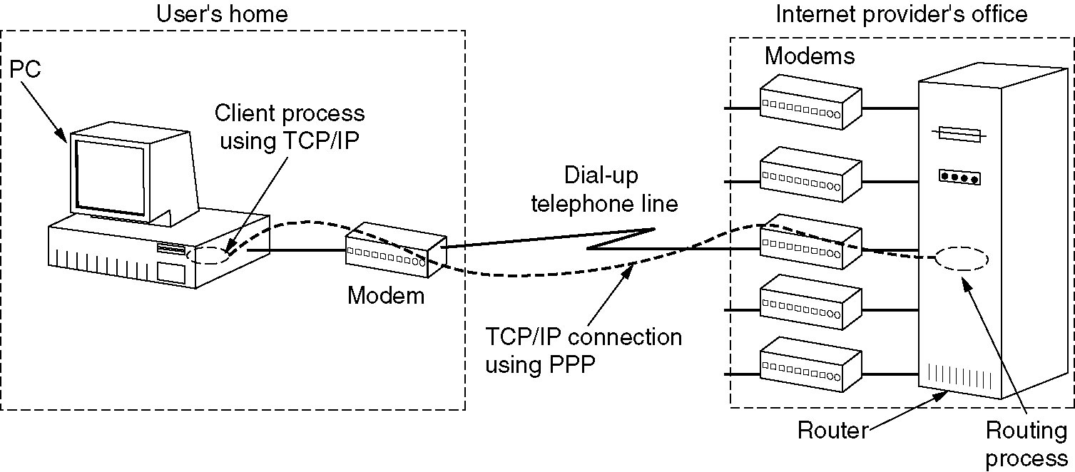
The Data Link Layer in the Internet
A home personal computer acting as an internet host.
Technology like Ethernet cannot provide “high-level” functionality like connection management and parameter negotiation

Slide 3
Point to Point Data Link Control
One sender, one receiver, one link: easier than broadcast link:
No Media Access Control
No need for explicit MAC addressing
E.g., dialup link, ISDN line
Popular point-to-point and high-level DLC protocols:
PPP (point-to-point protocol)
HDLC: High level data link control (Data link used to be considered “high layer” in protocol stack). HDLC is also used in multi-point links (one station many receivers)
These protocols can often be run over other data link technologies providing best of both worlds
E.g., PPPoE, HDLC encapsulation by Ethernet

Slide 4
PPP Design Requirements [RFC 1557]
Functionality : (similar to link layer services + extra management functions)
Packet framing - encapsulation of network-layer datagram in data link frame
Multi-protocol - carry network layer data of any network layer protocol (not just IP) at same time ability to demultiplex upwards
Bit transparency - must carry any bit pattern in the data field (even if underlying channel can't)
Error detection - not correction

Slide 5
PPP Design Requirements (cont.)
The extra stuff:
Connection liveness: detect, signal link failure to network layer
Network layer address negotiation: endpoint can learn/configure each other’s network address and other characteristics.
Authentication: who are you (or at least whose account do I bill for your dial-in time?)
This information is used by traffic management software to control bandwidth to individual subscribers
Management features: loopback detection

Slide 6
PPP non-requirements
No error correction/recovery
(modems do one layer FEC, one layer packetization + retransmission “under the covers” anyway; other technologies are pretty reliable)
No flow control
Out of order delivery OK
Error recovery, flow control, data re-ordering
all relegated to higher layers!

Slide 7
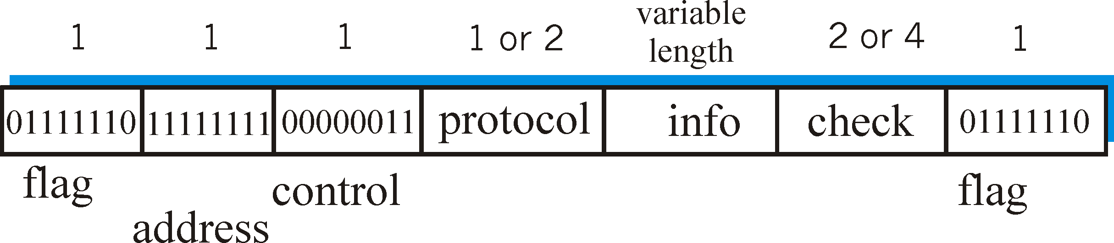
PPP Data Frame
Flag: delimiter (framing)
Address: ignored. (historical)
Control: ignored. (historical)
Protocol: upper layer protocol to which frame delivered (e.g., PPP-LCP, IP, IPCP, etc)

Slide 8
PPP Data Frame
info: upper layer data being carried
check: cyclic redundancy check for error detection

Slide 9
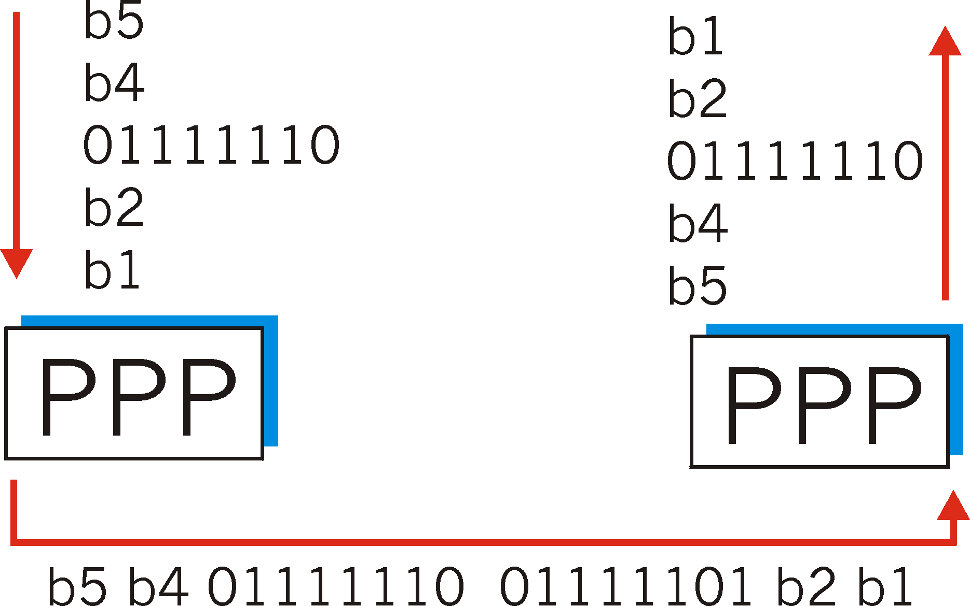
Byte Stuffing
flag byte
pattern
in data
to send
flag byte pattern plus
stuffed byte in transmitted data

Slide 10
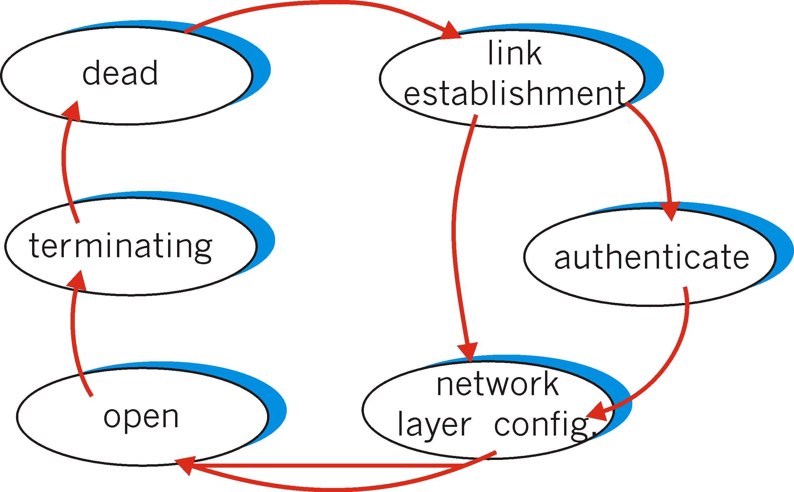
PPP Data Control Protocol
Before exchanging network-layer data, data link peers must
Configure PPP link (max. frame length, authentication)
Learn/configure network
layer information
for IP: carry IP Control Protocol (IPCP) msgs (protocol field: 8021) to configure/learn IP address

Slide 11
Where does PPP get used?
Dial-up – PPP over async serial, over modem
ADSL – PPP over Ethernet
Backbone – Packet over SONET (POS)
Why?
Framing (dialup, POS)
Efficiency (POS)
Authentication, address negotiation (PPPoE)

Slide 12
High-Level Data Link Control (HDLC)
HDLC was defined by ISO for use on both point-to-point and multipoint data links.
It supports full-duplex communication
Other similar protocols are
Synchronous Data Link Control (SDLC) by IBM
Advanced Data Communication Control Procedure (ADCCP) by ANSI
Link Access Procedure, Balanced (LAP-B) by CCITT, as part of its X.25 packet-switched network standard

Slide 13
HDLC Overview
Broadly HDLC features are as follows:
Reliable protocol
selective repeat or go-back-N
Full-duplex communication
receive and transmit at the same time
Bit-oriented protocol
use bits to stuff flags occurring in data
Flow control
adjust window size based on receiver capability
Uses physical layer clocking and synchronization to send and receive frames

Slide 14
HDLC Overview
Defines three types of stations
Primary
Secondary
Combined
Defines three types of data transfer mode
Normal Response mode
Asynchronous Response mode
Asynchronous Balanced mode
Three types of frames
Unnumbered
information
Supervisory

Slide 15
HDLC
The three stations are :
Primary station
Has the responsibility of controlling the operation of data flow the link.
Handles error recovery
Frames issued by the primary station are called commands.
Secondary station,
Operates under the control of the primary station.
Frames issued by a secondary station are called responses.
The primary station maintains a separate logical link with each secondary station.
Combined station,
Acts as both as primary and secondary station.
Does not rely on other for sending data

Slide 16
HDLC
Unbalanced Mode
Commands
Primary
Responses
Secondary
Secondary
Balanced mode
Combined
Combined
commands/Responses

Slide 17
HDLC
The three modes of data transfer operations are
Normal Response Mode (NRM)
Mainly used in terminal-mainframe networks. In this case,
Secondaries (terminals) can only transmit when specifically instructed by the primary station in response to a polling
Unbalanced configuration, good for multi-point links
Asynchronous Response Mode (ARM)
Same as NRM except that the secondaries can initiate transmissions without direct polling from the primary station
Reduces overhead as no frames need to be sent to allow secondary nodes to transmit
Transmission proceeds when channel is detected idle , used mostly in point-to-point-links
Asynchronous Balanced Mode (ABM)
Mainly used in point-to-point links, for communication between combined stations

Slide 18
Non-operational Modes
Normal Disconnected Mode
Asynchronous Disconnected Mode
Both the above modes mean that the secondary node is logically disconnected from the primary node
Initialization Mode
A node negotiates transmission parameters with the other node E.g., flow control information
Parameters negotiated in this mode are used during any of the data transfer modes

Slide 19
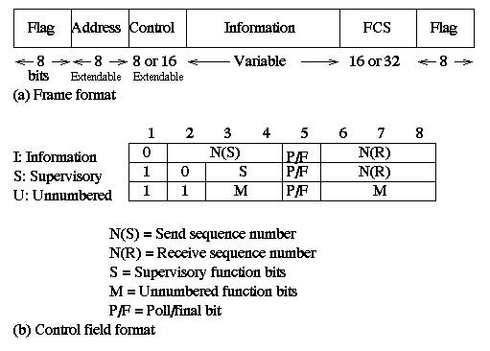
Data Link Control HDLC frame structure
(a) Frame
Format
(b) Control
field
format
Notes:
2

Slide 20
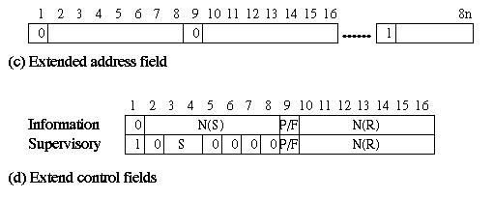
Data Link Control HDLC frame structure
(c) Extended address field
(d) Extended control field
Notes:
2

Slide 21
HDLC
Flag: 01111110- start and ending delimiter. Bits are stuffed for flags in data frames
FCS: 16-bit CRC using generating polynomial
G(x) = x¹⁶ + x¹² + x⁵ + 1
Address field:
mainly used in multidrop link configuration, and not used in point-to-point
In unbalanced configuration, every secondary is assigned a unique address. Contains address of secondary station in both command and response frames
In balanced mode, command frame has destination address and response frame has sending node’s address
Group addresses are also possible. E.g., One command sent to all the secondaries
In I-frames, N(s) is the sequence number of the frame being sent, and R(s) is the sequence number of the frame being expected.
The P/F bit, known as the poll/final bit, is used with different meaning in different contexts.
It is used to indicate polling, to indicate the final I-frame, etc

Slide 22
HDLC
There are three different classes of frames used in HDLC
Unnumbered frames, used in link setup and disconnection, and hence do not contain ACK.
Information frames, which carry actual information. Such frames can piggyback ACK in case of ABM
Supervisory frames, which are used for error and flow control purposes and hence contain send and receive sequence numbers

Slide 23
HDLC
There are four different supervisory frames
SS=00, Receiver Ready (RR), and N(R) ACKs all frames received up to and including the one with sequence number N(R) - 1
SS=10, Receiver Not Ready (RNR), and N(R) has the same meaning as above
SS=01, Reject; all frames with sequence number N(R) or higher are rejected, which in turns ACKs frames with sequence number N(R) -1 or lower.
SS=11, Selective Reject; the receive rejects the frame with sequence number N(R)

Slide 24
HDLC
The unnumbered frames can be grouped into the following categories:
Mode-setting commands and responses
Recovery commends and responses
Miscellaneous commands and responses

Slide 25
Review of Link Layer
Services
Framing
Error control
Reliability
Connection management
Medium access control
Switching
Protocols, Standards
Ethernet
Token Ring
FDDI
Wireless
PPP
HDLC

